Slide 1

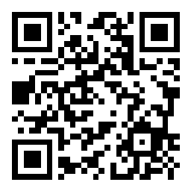
10 quick tips for making your software outlive your job
https://arxiv.org/abs/2505.06484
Richard Littauer - http://richard.social
Rimu https://www.inaturalist.org/observations/198921399

Slide 2
Who is this Richard Littauer, anyway
PhD student in CS
Building Tools for Community Science Datasets to Model Bird Populations and Highly Pathogenic Avian Influenza in Aotearoa New Zealand
Also:
Python.nz and KiwiPycon.nz
CURIOSS.org
SustainOSS.org
OpenSustain.Tech
Source not given

Slide 3
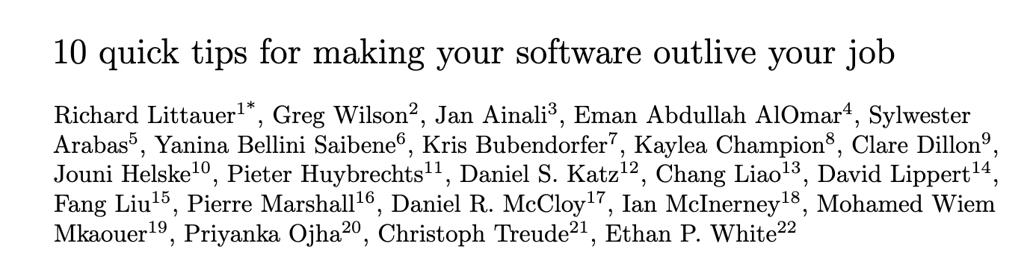

Slide 4
Why care?
Academic life is uncertain
Funding changes and people move between roles
National and international funding is at risk
Open Source software is more resilient
Your work will last longer if you care about it lasting longer.

Slide 5
Stay within the law
Ask about university policies
Ask about department policies
Ask about coauthors
Ask about your next role

Slide 6
2. Define your threat model
Individual
Leadership
Institutional
Global

Slide 7
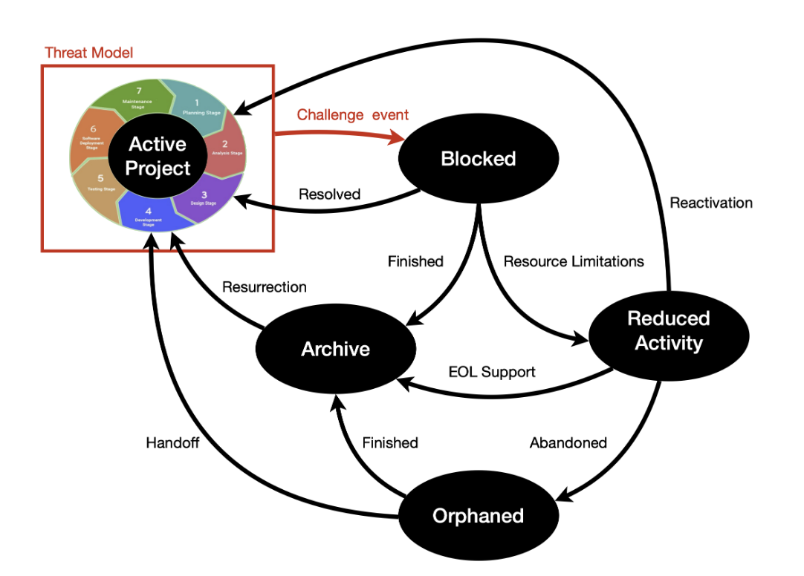
3. Decide if you are ending, pausing, or handing
off

Slide 8
4. Choose an open license (if you can)
Choosealicense.com
Open Source Inititiave
Ethical licenses
Tīkanga licenses

Slide 9
5: Save everything in multiple places
GitHub
Codeberg
Personal websites

Slide 10
6: Encourage community adoption
Publishing != publicizing
Social media, forums, mailing lists
Tutorials, conferences

Slide 11
7: Do what you’re supposed to (if you have time)
DOI with Zenodo
Peer review
Document
Document data
Describe dependencies
Write tests
Contribution guides

Slide 12
8: Do what you can (if you have to act quickly)
Say what your code does and how to use it
Make a screencast
Save it in the Software Heritage Archive
Clean up code
Say why you're leaving

Slide 13
9: Talk about what you’re doing
Share what you're doing beyond the code
Write down what has happened in your own logs
Process your emotions.

Slide 14
10: Organize
Don't just play defense.
Professional societies
Boards, academic or otherwise
Scientific comms work.

Slide 15
Thank you.
Questions?

